Slide 1
Solutions Assignment 1
Threat Enumeration, Tactics

Slide 2
Assignment 1 objectives
Q1 is an exercise in comparing different approaches to solve a problem.
This is a common research activity, in every paper or proposal we write we need to compare our new results to existing solutions, indicating what is better, what is new, and what is different. A survey requires to compare many solutions.
Q2 is about validating a new result. This is also needed in every paper. Validation can be done by experiment, by logical argument, or by building examples. Sometimes, by a combination of these approaches.

Slide 3
Assignment 1
Q1
Compare misuse cases to our way to enumerate threats (Chapter 1 in slides, Chapter 2 in notes).
Q2
In my paper on tactics (attached), I say that our tactic set is “better” than the original set. How would you prove this assertion?
Indicate all possible ways you can think of or find (with references)

Slide 4
My method, based on Misuse activities (MA)

Slide 5
Threats
T1.The customer is an impostor and opens an account in the name of another person
T2.The customer provides false information and opens an spurious account
T3.The manager is an impostor and collects data illegally
T4.The manager collects customer information to use illegally
T5.The manager creates a spurious account with the customer’s information
T6.The manager creates a spurious authorization card to access the account
T7.An attacker tries to prevent the customers to access their accounts
T8.An attacker tries to move money from an account to her own account

Slide 6
Threat enumeration

Slide 7
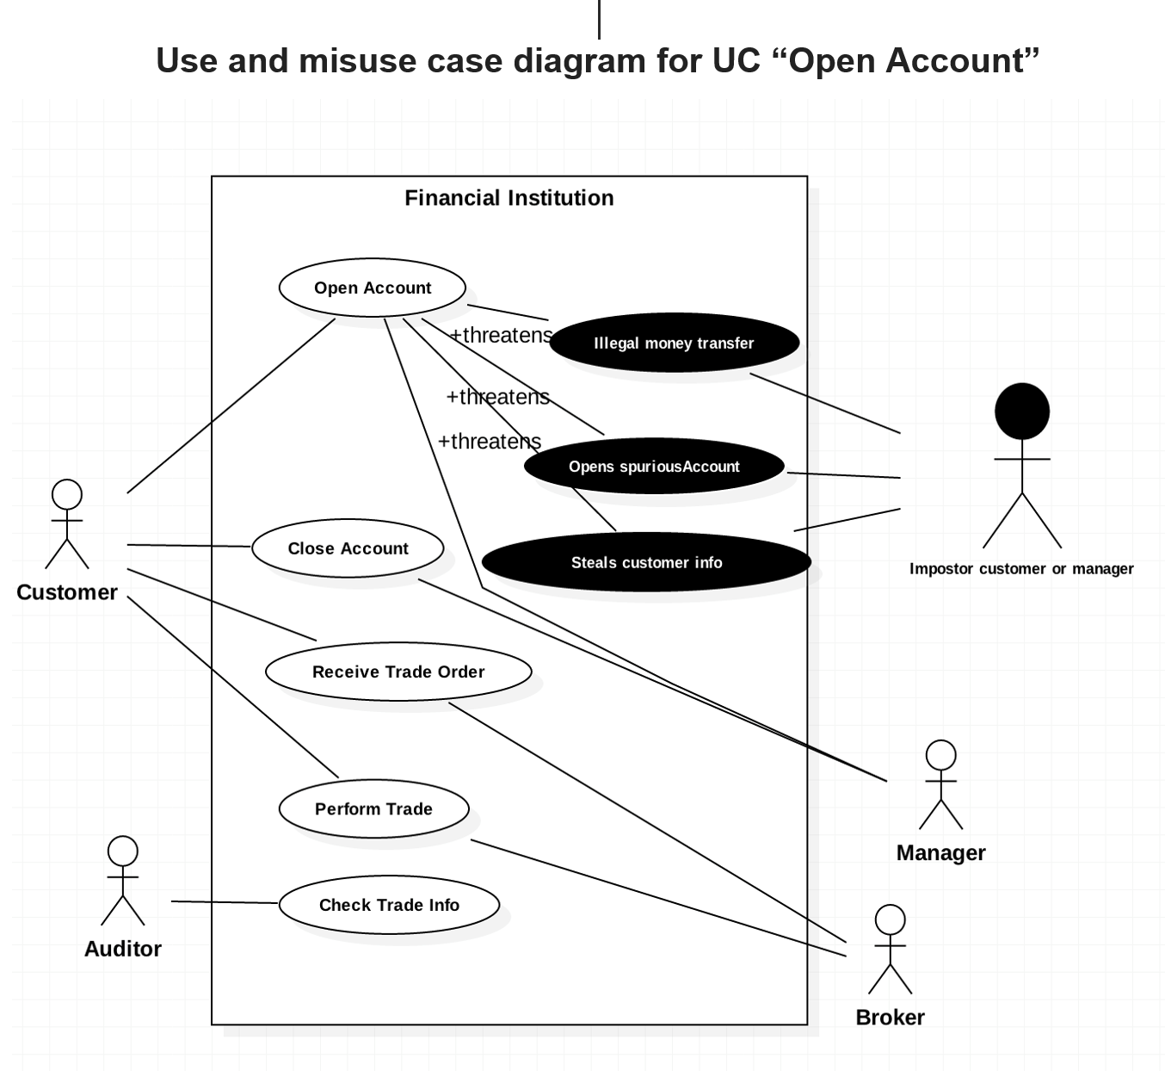

Slide 8
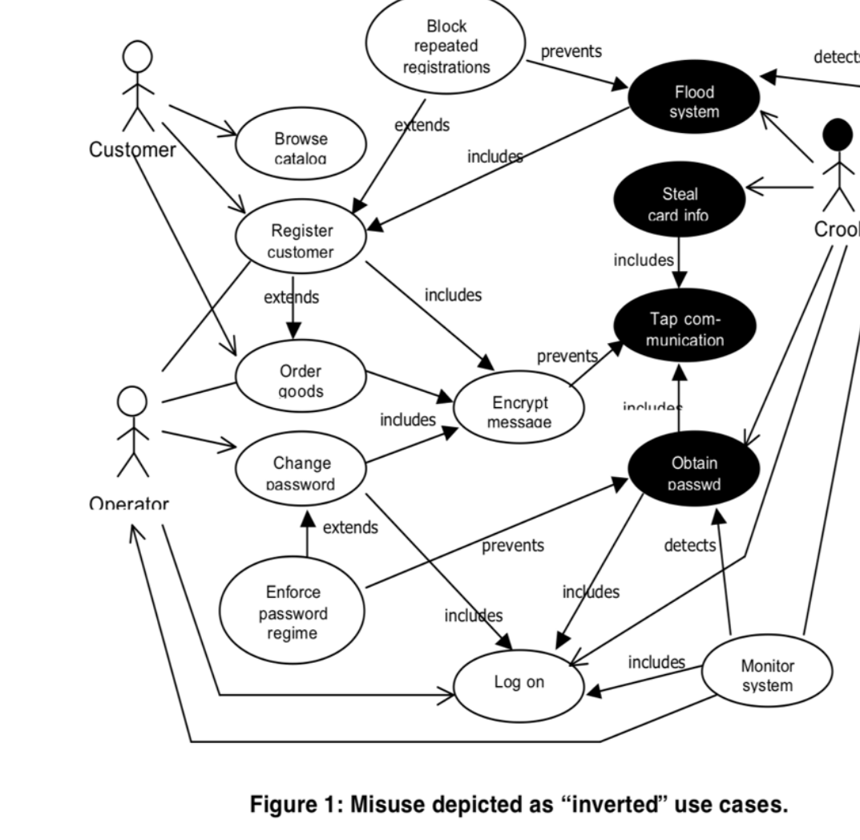

Slide 9
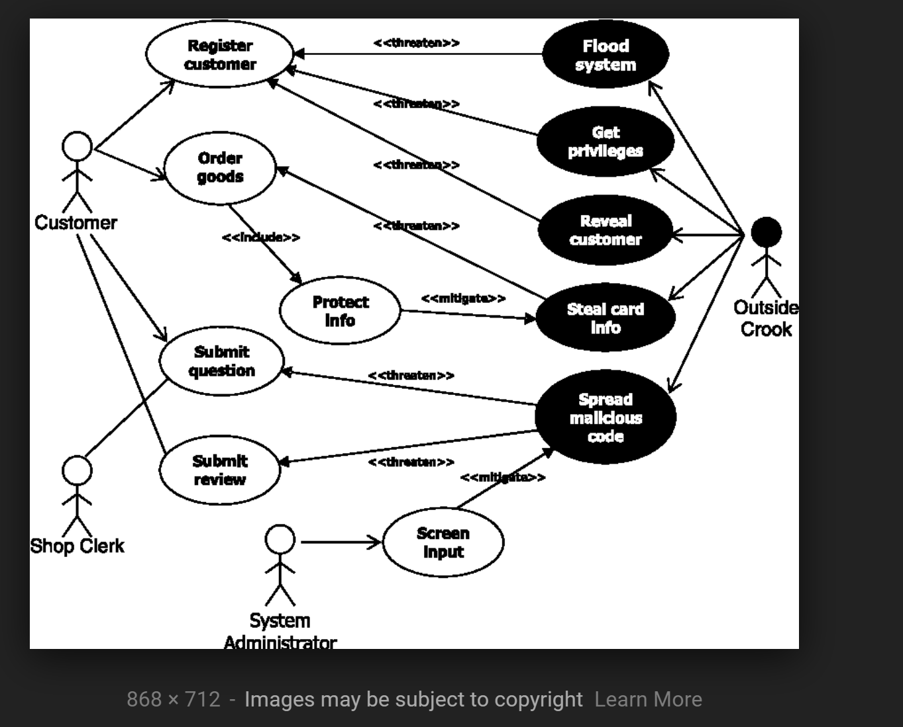
Misuse cases

Slide 10
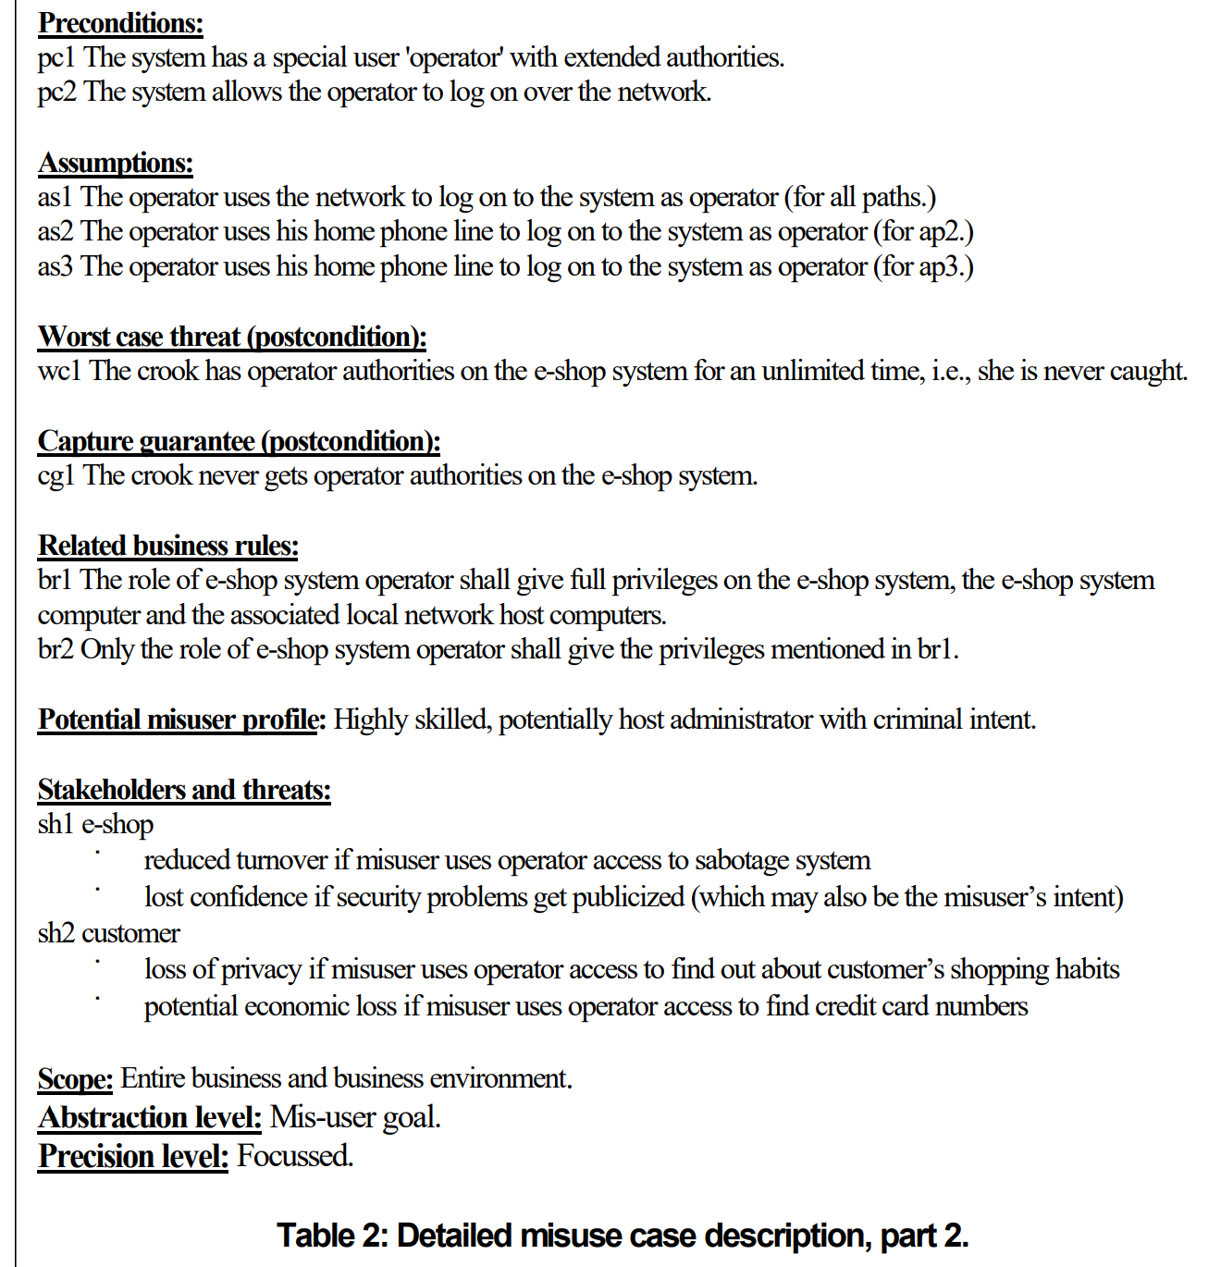

Slide 11
Comparison of MA (misuse activities) with MC (misuse cases)
+It is clear that MA is more systematic, all activites are considered, while in MC the designer has to create possible misuse cases
+Because of being more systematic and more fine-grained ( a use case has several activities), MA should produce more threats
+MA is easier to apply because the designer requires less experience; in MC the designer has to postulate possible attacks
+MC requires the use case model to find threats while MA can be done using a table; graph models become unreadable if there are many use cases (frequent)
-MA requires to know about UML activity diagrams, which is not needed for MC

Slide 12
Another good solution

Slide 13
Errors
Q1
Long, verbose fuzzy discussions.
No conclusions after showing examples.
Confusion of use cases with activities in use cases
One paper compared misuse cases to tactics !
General:
Answer uploaded in two files instead on one
Bibliography instead of references
References for Q1 and Q2 in one list

Slide 14
Q2 answer
Note that “better” in this case means an improvement on the original set, not a replacement.
We discarded experimental validation (next slide)
For validation we used arguments about completeness (Fig. 10), application of the tactics to standard styles (MVC, three tier), referred to the work of others, an example, and justified each change.
We also showed a mapping from the new tactics to security patterns to show it was easy to do
However, our arguments are not well structured and we did not consider architecture analysis methods such as ATAM and AAFS
We got some new references and specific ideas from this assignment

Slide 15
Why an experimental evaluation is not possible
Tactics are not a complete methodology, they must be complemented with some realization such as security patterns. So any experiment would have to embed both sets of tactics in some methodology, try these methodologies with a group of software developers and measure the result using several examples [Fer16].
One problem is to separate the effect of the methodologies from the tactics.
Another is what to measure: degree of security of the products, ease of use,…?

Slide 16
A possible idea: ATAM
A way to evaluate the new set of tactics would be by utilizing an architecture evaluation method called Architecture Tradeoff Analysis Method (ATAM). Its purpose is to evaluate a software architecture in development or even completed by evaluating trade-offs and sensitivity points of the architecture. ATAM also reveals how well an architecture satisfies quality goals and insight into how these quality goals interact.
We would need to build and evaluate an architecture utilizing ATAM for both the original tactic set and the new tactic set. The new set should result in a better architecture. Unless we evaluate many architectures this would also be an example. In addition, ATAM seems too general (security, performance, reliability,…) and takes too much time.

Slide 17
Another method: AAFS
Another evaluation method is AAFS (Architecture Analysis for Security) [Ryo15].
It is similar in objectives to ATAM, but more specialized, evaluates design decisions about security.
It first interviews architects of an architecture to find out what tactics they used.
The tactics are then mapped to a set of 124 security patterns.
The patterns are used to focus on their code realizations and expected vulnerability categories according to CWE.
If the found vulnerabilities are not covered, the system is reinforced
It could be possible to show that the new set provides a better architecture analysis but its use only provides an example (as in ATAM).

Slide 18
A better logical argument for validation
We intend to structure our validation section to show that our tactics are an improvement in the following aspects:
Completeness--The new tactics cover all the architectural levels of a system [Uzu16], which is not clear for the original set
Usability--The new tactics are easier to use than the original set because they have a clearer mapping to specific security patterns.
Degree of security--The clear mapping from tactics to patterns in our set means that it is possible to evaluate the degree of security of a system, something that cannot be done using the original set of tactics.
Precision--The mapping of tactics to security patterns of the new set is very precise; if you consider SSFs each tactic leads to one or two SSFs.

Slide 19
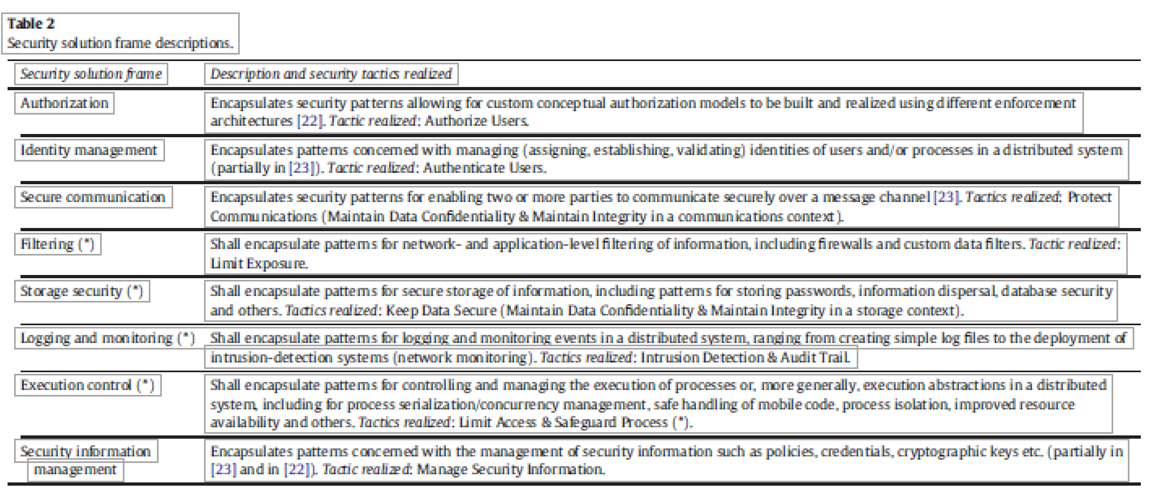

Slide 20
References
Abdelkareem M. Alashqar, Hazem M. El-Bakry, Ahmad Abo Elfetouh, “A Framework For Selecting Architectural Tactics Using Fuzzy Measures”, Int. J. of Software Engineering and Knowledge Eng., vol. 27, no. 3, pp. 475-498, 2017.
ATAM, https://resources.sei.cmu.edu/library/asset-view.cfm?assetid=513908
[Fer16] E.B.Fernandez and HernanAstudillo, “Experimental Evaluation of Secure Software Methodologies using Patterns”, 11th Latin American Pattern Languages of Programs Conference, Buenos Aires, Argentina, November 14-18, 2016
[Ryo15] J. Ryoo, R. Kazman and P. Anand, "Architectural Analysis for Security," in IEEE Security & Privacy, vol. 13, no. 6, pp. 52-59, Nov.-Dec. 2015.
J. Ryoo, B. Malone, P. A. Laplante and P. Anand, "The Use of Security Tactics in Open Source Software Projects," IEEE Trans. on Reliability, vol. 65, no. 3, pp. 1195-1204, 2016.
A. E. Sabry, "Decision Model for software Architectural Tactics Selection based on Quality Attributes Requirements," Procedia Computer Science, vol. 65, pp. 422-431, 2015.
J. C. S. Santos, A. Peruma, M. Mirakhorli, M. Galstery, J. V. Vidal and A. Sejfia, "Understanding Software Vulnerabilities Related to Architectural Security Tactics: An Empirical Investigation of Chromium, PHP and Thunderbird," in IEEE Int. Conf. on Software Architecture (ICSA), Gothenburg, Sweden, 2017.

Slide 21
Assignment 2 (due Th Nov 15)
Q1. We would like to combine the Cyber Kill Chain (CKC) Model with our misuse patterns. Describe the idea and use as example the DDoS attack using Botnets or a similar attack. Bonus: combine misuse patterns with SAMIIT to get a misuse pattern for CPS and IoT.
Q2. Study OpenStack security. Find threats and countermeasures. Look in the Internet, make a structured and systematic list according to architectural effects.
As usual, write concisely and precisely, itemize your key ideas (no long, verbose paragraphs), give references when appropriate.

Slide 22
Talk on Wed at noon, EE405
A pattern for Controlled Access to a Cargo Port Terminal Physical Structure
Abstract
Cyber-physical systems (CPSs) are systems that integrate physical processes, computational resources, and communication capabilities with the monitoring and/or control of entities in the physical world. An important type of CPS is a maritime container terminal. Maritime container terminals are facilities where cargo containers are transported between ships and land vehicles, for example trains or trucks, for onward transportation, and vice versa. Every maritime terminal performs four basic functions: receiving, storage, staging and loading for both, import and export containers. Port automation has been playing an increasing role with the introduction of robots, artificial intelligence and other digital tools that keep the goods flowing into and out of major ports. The need to protect assets in buildings and to control access to restricted areas in a container terminal is a strong requirement in the cargo port design and container handling protection. A cargo port requires a specific set of functional roles that need to be mapped to specific controlled physical access. This pattern illustrates the core functional units of a cargo port terminal, the organization of its physical locations, and the approach used to assign permissions to individuals or roles to access such locations.
Virginia Romero is a PhD candidate in the College of Engineering and Computer Science at Florida Atlantic University. She has a MS in Computer Engineering from Florida Atlantic University and a BS in Computer Science from The University of Tennessee. She is an experienced project manager with over twenty years dedicated to research and analysis, resource management, budgeting, forecasting and project team coordination for different technology areas for Techno-Transfers of Florida, her own computer consulting firm. Previously, she worked for IBM, Honeywell and Siemens as a Research and Development Software Architect, where she designed, implemented, managed, reviewed and provided technical guidance for all stages of the software development cycle, from requirements to design, to implementation to testing through system integration and customer support.

